Slide 1
HR. Analytics PROJECT
Group 3

Slide 2
INTRODUCTION
HR Analytics helps organizations analyze employee data to improve workforce performance, employee satisfaction, and business productivity. This project focuses on transforming raw HR data into meaningful insights using Excel, SQL, Tableau, and Power BI.

Slide 3
Dashboard Tools Used
Excel
Power BI
Tableau
SQL Queries

Slide 4
Data Flow Process
Raw Data → Data Cleaning → Data Transformation → Dashboard Creation → Business Insights

Slide 5
KPI AND INSIGHTS
• Attrition is highest in age group 50–60. • Research & Development and Sales departments show high attrition. • Male and female employee counts are nearly equal.

Slide 6
KPI AND INSIGHTS
Employee Count: 50K
Attrition Rate: 50.21%
Average Salary: 26.02K
Average Age: 38.97
Average Hourly Rate: 115.43
Work-Life Balance: 2.50
Total Employees Analyzed: 50K
Overall Attrition Percentage: 50.21%.
Average Employee Salary: 26.02K
Average Workforce Age: 38.97 Years
Average Employee Hourly Rate: 115.43
Overall Work-Life Balance Score: 2.50

Slide 7
IMPORTANCE OF FILTTERS
In the HR Analytics project, filters (also called slicers) play an important role in converting a static dashboard into an interactive analytical tool.
Filters help users:
Analyze employee data department-wise.
Compare attrition between male and female employees.
Track work-life balance across different job roles.
Identify age groups with higher attrition rates.
Monitor promotion trends and employee retention.
Perform dynamic and faster HR decision-making.
Focus on specific employee segments for deeper analysis.
Improve workforce planning and performance evaluation.

Slide 8
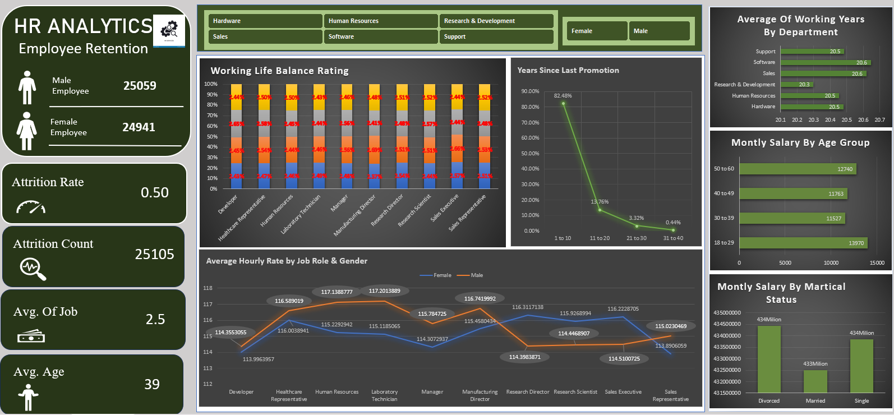
EXCEL DASHBOARD

Slide 9
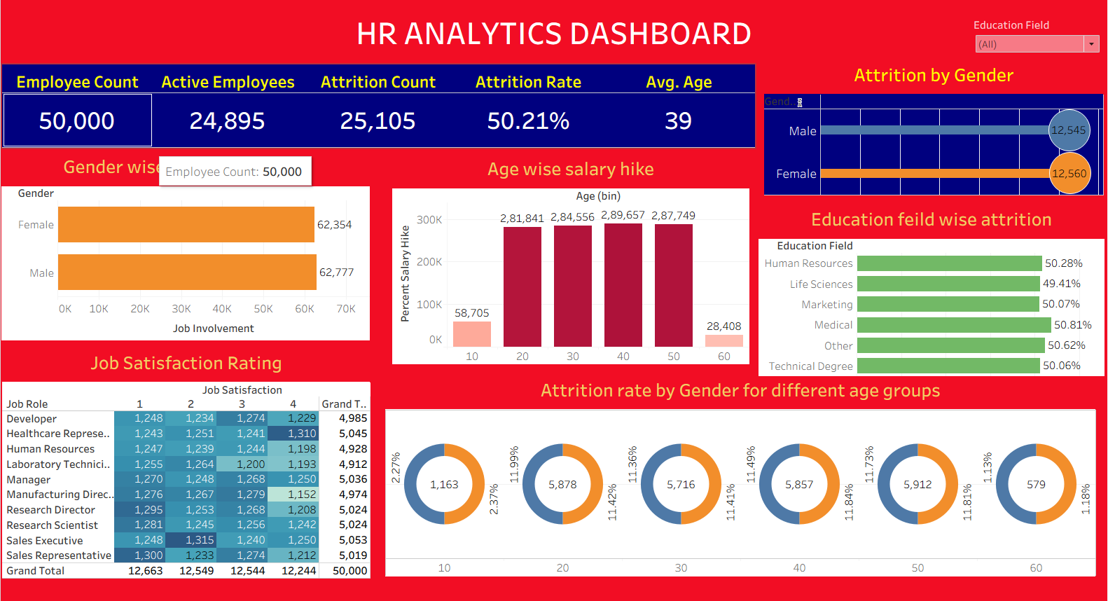
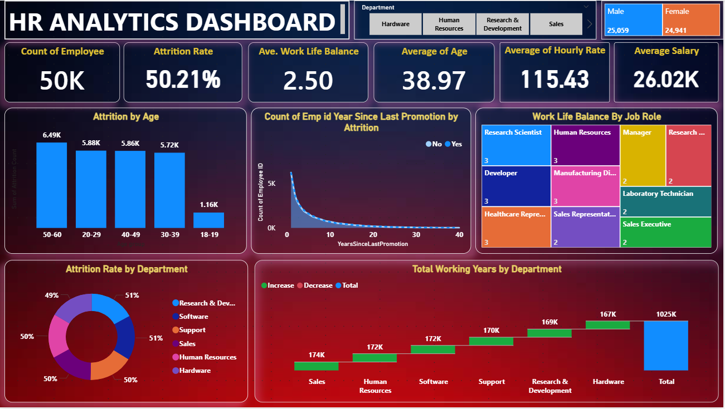
TABLEAU DASHBOARD

Slide 10
POWER BI DASHBOARD

Slide 11
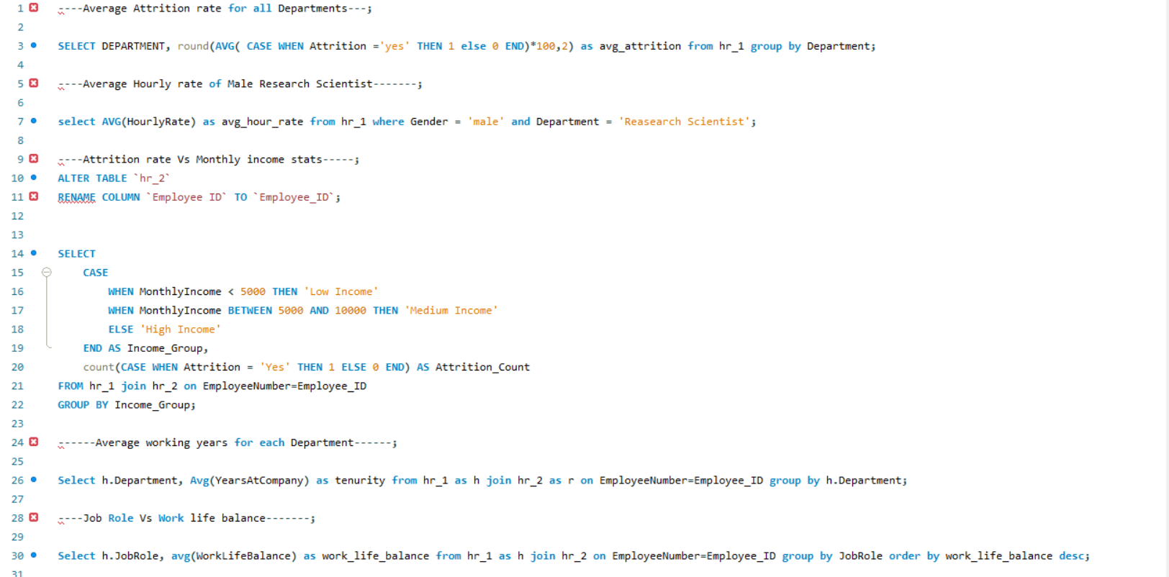
SQL ( STRUCTURED QUERY LANGUAGE )

Slide 12
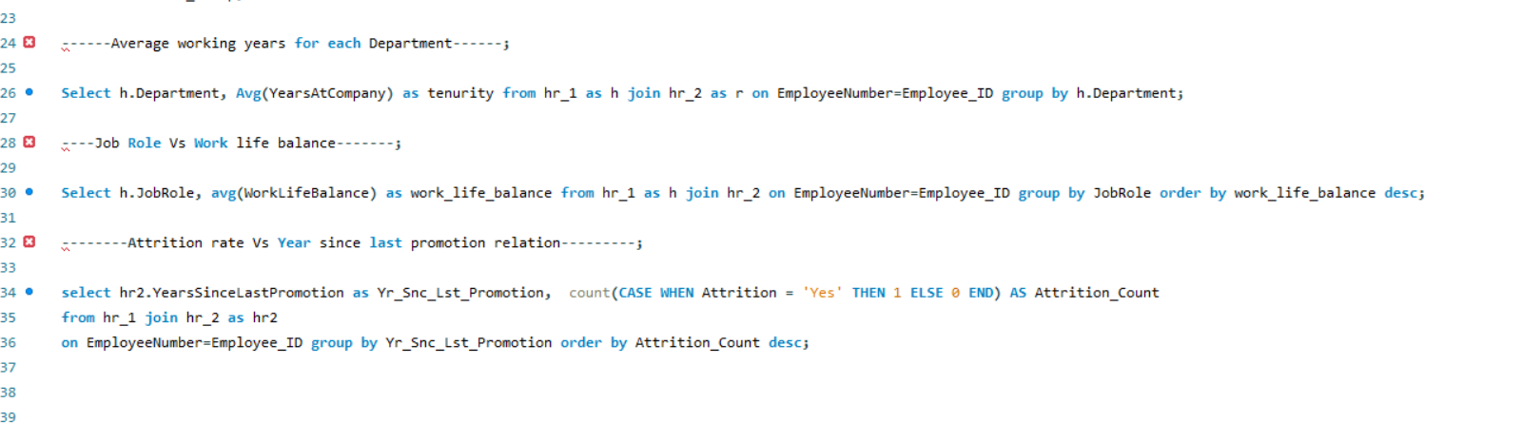

Slide 13
PROJECT SUMMARY
The project successfully analyzed workforce data and identified attrition trends, salary patterns, and department-wise employee insights. It also helped in understanding employee work-life balance, promotion trends, and workforce distribution across different job roles. The dashboard enables HR teams to make data-driven decisions, improve employee retention strategies, optimize workforce planning, and enhance overall organizational performance through interactive visualizations and KPI tracking.

Slide 14
CONCLUSION
The HR Analytics project transforms raw HR data into actionable insights using Excel, SQL, Tableau, and Power BI. The project helps organizations monitor important HR KPIs such as employee count, attrition rate, salary distribution, work-life balance, and promotion trends. Interactive dashboards and visualizations enable HR teams to analyze department-wise performance, identify workforce patterns, improve employee retention strategies, and support data-driven decision-making for better organizational growth and workforce management.

Slide 15
THANK YOU
GROUP 3

